Slide 1

Programming Your GPU with OpenMP*
Simon McIntosh-Smith, Matt Martineau, Andrei Poenaru, Patrick Atkinson
University of Bristol
simonm@cs.bris.ac.uk
* The name “OpenMP” is the property of the OpenMP Architecture Review Board.

Slide 2
Preliminaries: Part 2
Our plan for the day .. Active learning!
We will mix short lectures with short exercises.
You will use your laptop to connect to a multiprocessor server.
Please follow these simple rules
Do the exercises that we assign and then change things around and experiment.
Embrace active learning!
Don’t cheat: Do Not look at the solutions before you complete an exercise … even if you get really frustrated.

Slide 3

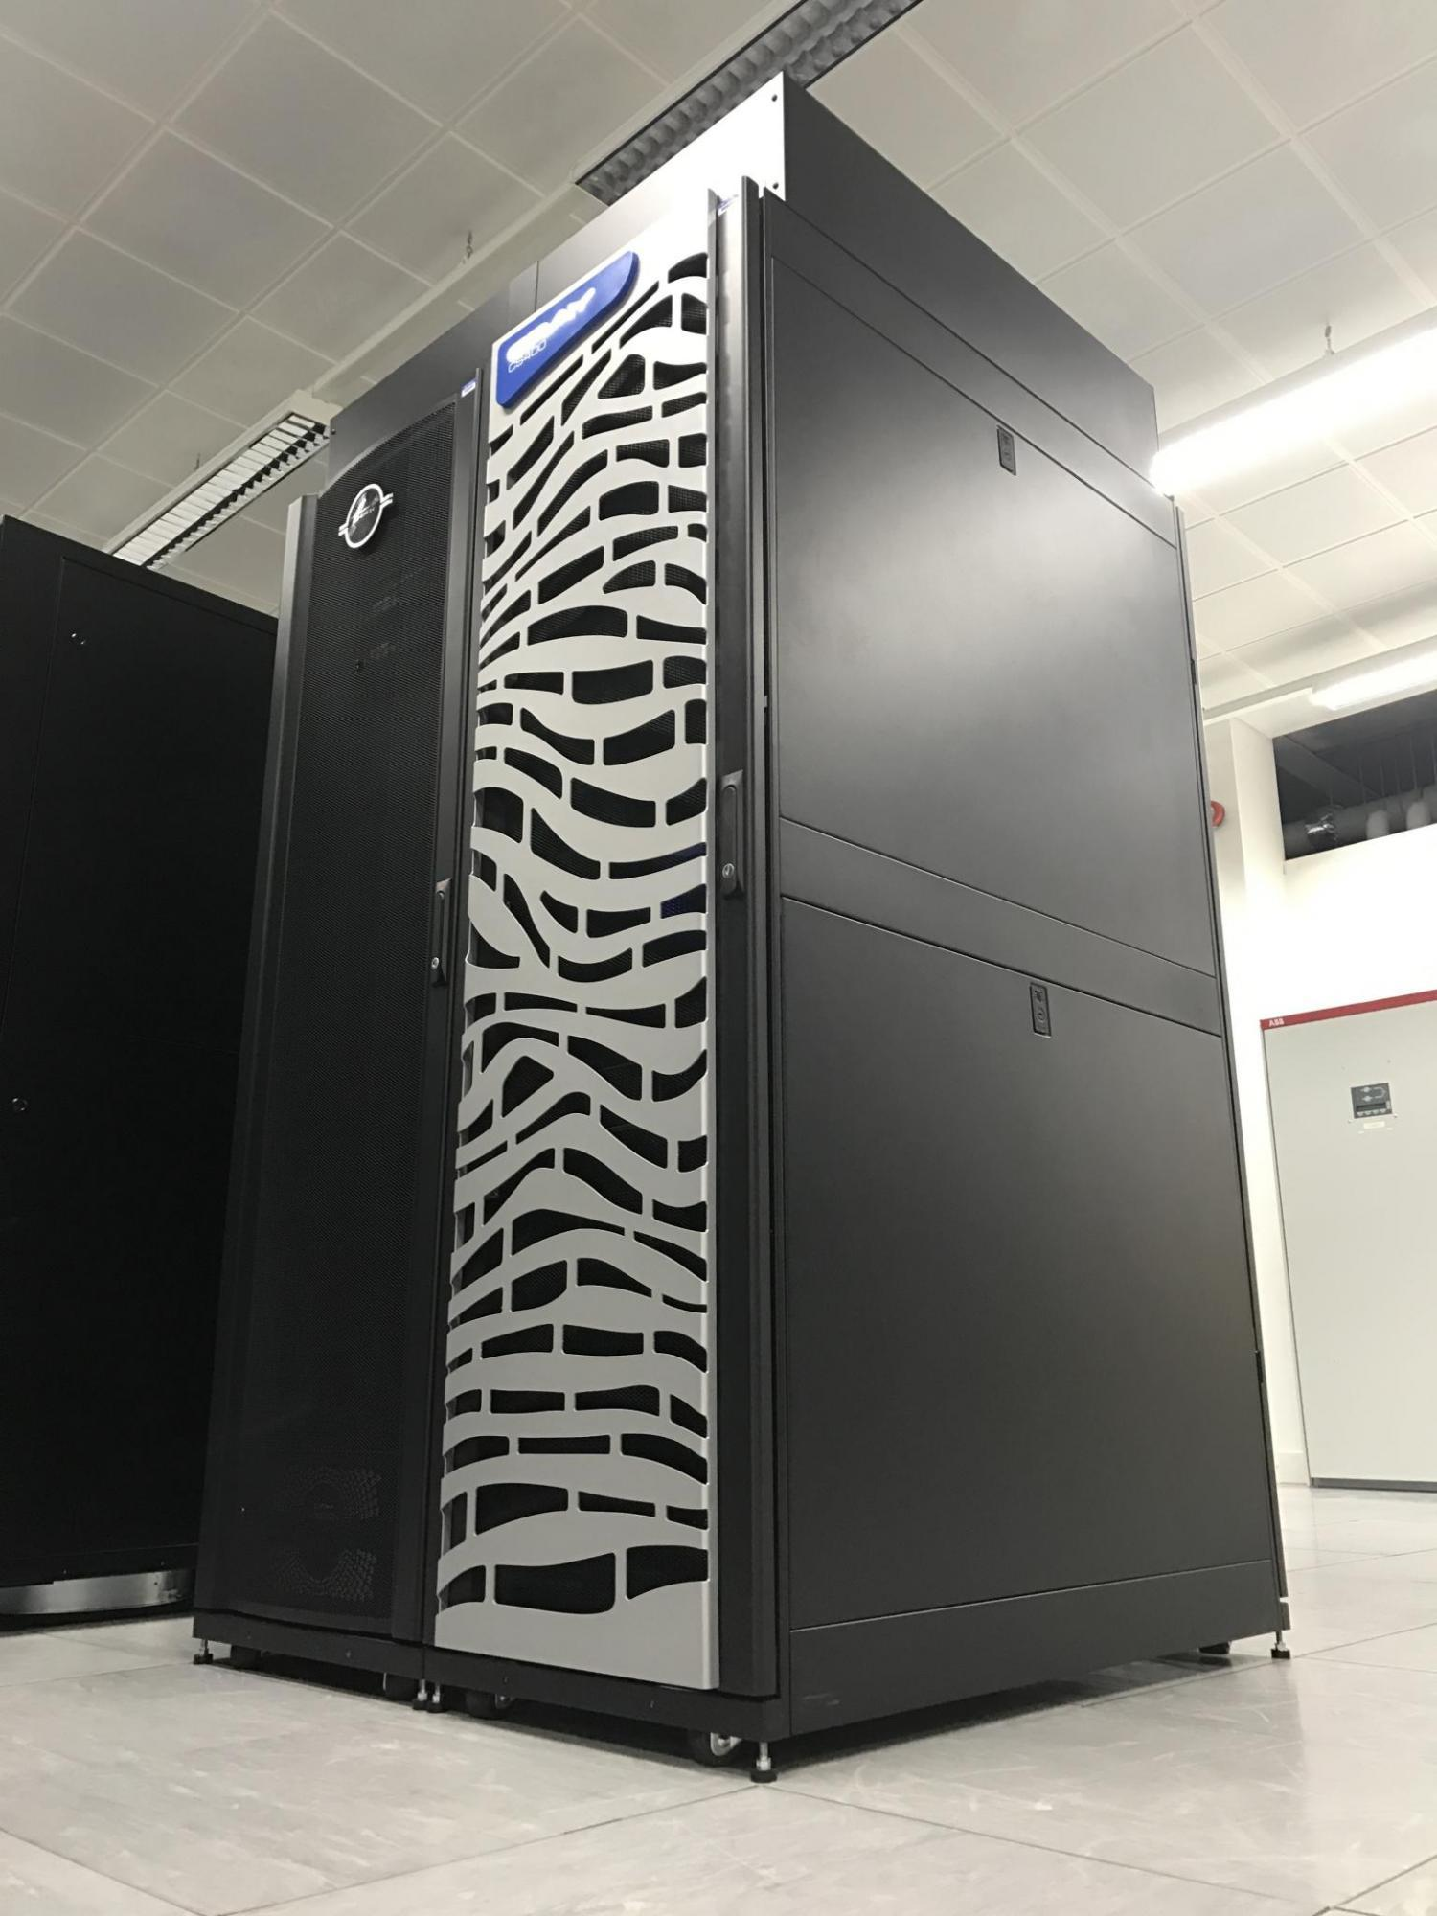




Collaboration between GW4 Alliance (universities of Bristol, Bath, Cardiff, Exeter), the UK Met Office, Cray, and Arm
~£3 million, funded by EPSRC
Expected to be the first large-scale, Arm-based production supercomputer
10,000+ Armv8 cores
Also contains some Intel Xeon Phi (KNL), Intel Xeon (Broadwell), and NVIDIA P100 GPUs
Cray compilers provide the OpenMP implementation for GPU offloading

Slide 4
Plan
Module | Concepts | Exercises
OpenMP overview | OpenMP recap Hardcore jargon of OpenMP | None … we’ll use demo mode so we can move fast
The device model in OpenMP | Intro to the Target directive with default data movement | Vadd program
Understanding execution | Intro to nvprof | nvprof ./vadd
Working with the target directive | CPU and GPU execution models and the fundamental combined directive | Vadd with combined directive using nvprof to understand execution
Basic memory movement | The map clause | Jacobi solver
Optimizing memory movement | Target data regions | Jacobi with explicit data movement
Optimizing GPU code | Common GPU optimizations | Optimized Jacobi solver

Slide 5
Agenda
OpenMP overview
The device model in OpenMP
Understanding execution on the GPU with nvprof
Working with the target directive
Controlling memory movement
Optimizing GPU code
CPU/GPU portability

Slide 6
OpenMP:
C$OMP FLUSH
#pragma omp critical
C$OMP THREADPRIVATE(/ABC/)
CALL OMP_SET_NUM_THREADS(10)
OpenMP: An API for Writing Multithreaded Applications
A set of compiler directives and library routines for parallel application programmers
Greatly simplifies writing multi-threaded (MT) programs in Fortran, C and C++
Standardizes established SMP practice + vectorization and heterogeneous device programming
C$OMP parallel do shared(a, b, c)
call omp_test_lock(jlok)
call OMP_INIT_LOCK (ilok)
C$OMP MASTER
C$OMP ATOMIC
C$OMP SINGLE PRIVATE(X)
setenv OMP_SCHEDULE “dynamic”
C$OMP PARALLEL DO ORDERED PRIVATE (A, B, C)
C$OMP ORDERED
C$OMP PARALLEL REDUCTION (+: A, B)
C$OMP SECTIONS
#pragma omp parallel for private(A, B)
!$OMP BARRIER
C$OMP PARALLEL COPYIN(/blk/)
C$OMP DO lastprivate(XX)
Nthrds = OMP_GET_NUM_PROCS()
omp_set_lock(lck)
* The name “OpenMP” is the property of the OpenMP Architecture Review Board.

Slide 7
The OpenMP Common Core: Most OpenMP programs only use these 19 items
OpenMP pragma, function, or clause | Concepts
#pragma omp parallel | Parallel region, teams of threads, structured block, interleaved execution across threads
int omp_get_thread_num() int omp_get_num_threads() | Create threads with a parallel region and split up the work using the number of threads and thread ID
double omp_get_wtime() | Speedup and Amdahl's law. False Sharing and other performance issues
setenv OMP_NUM_THREADS N | Internal control variables. Setting the default number of threads with an environment variable
#pragma omp barrier #pragma omp critical | Synchronization and race conditions. Revisit interleaved execution.
#pragma omp for #pragma omp parallel for | Worksharing, parallel loops, loop carried dependencies
reduction(op:list) | Reductions of values across a team of threads
schedule(dynamic [,chunk]) schedule (static [,chunk]) | Loop schedules, loop overheads and load balance
private(list), firstprivate(list), shared(list) | Data environment
nowait | Disabling implied barriers on workshare constructs, the high cost of barriers. The flush concept (but not the concept)
#pragma omp single | Workshare with a single thread
#pragma omp task #pragma omp taskwait | Tasks including the data environment for tasks.

Slide 8
Agenda
OpenMP overview
The device model in OpenMP
Understanding execution on the GPU with nvprof
Working with the target directive
Controlling memory movement
Optimizing GPU code
CPU/GPU portability

Slide 9
The OpenMP device programming model
OpenMP uses a host/device model
The host is where the initial thread of the program begins execution
Zero or more devices are connected to the host
…
…
#include <omp.h>
#include <stdio.h>
int main()
{
printf(“There are %d devices\n”,
omp_get_num_devices());
}
…
…
…
…
…
…
…
Host
…
…
…
…
…
…
Device

Slide 10
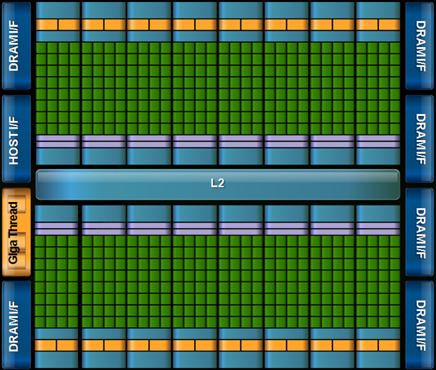
OpenMP with target devices
The target construct offloads execution to a device.
#pragma omp target
{….} // a structured block of code
Program begins. Launches Initial thread running on the host device.
Initial task on host continues once execution associated with the target region completes
Implicit parallel region surrounds entire program
Initial task begins execution
Initial thread encounters the target directive.
Initial task generates a target task which is a mergable, included task
A new initial thread runs on the device.
Target task launches target region on the device
Implicit parallel region surrounds device program
Initial task executes code in the target region.

Slide 11
Commonly used clauses with target
#pragma omp target [clause[[,]clause]...]
structured-block
if(scalar-expression)
If the scalar-expression evaluates to false then the target region is executed by the host device in the host data environment.
device(integer-expression)
The value of the integer-expression selects the device when a device other than the default device is desired
private(list) firstprivate(list)
creates variables with the same name as those in the list on the device. In the case of firstprivate, the value of the original variable on the host is copied into the private variable created on the device.
map(map-type: list[0:N])
map-type may be to, from, tofrom, or alloc. The clause defines how the variables in list are moved between the host and the device.
nowait
The target task is deferred which means the host can run code in parallel to the target region.

Slide 12
The target data environment
Scalars and statically allocated arrays that are referenced in the target region are moved onto the device implicitly before execution
Host thread
Generating Task
float A[N], B[N];
A, B and N mapped to the device
#pragma omp target
Initial task
Host thread
waits for the task region to complete
{
target region, can use A, B and N
}
Target task
Device Initial thread
the arrays A and B mapped back to the host
Only the statically allocated arrays are moved back to the host after the target region completes
Based on figure 6.4 in Using OpenMP – The Next Step by van der Pas, Stotzer and Terboven, MIT Press, 2017

Slide 13
Using Isambard (1/2)
# Log in to the Isambard bastion node
# This node acts as a gateway to the rest of the system
# You will be assigned an account ID (01, 02, …)
# Your password is openmpGPU18
ssh br-trainXX@isambard.gw4.ac.uk
# Log in to Isambard Phase 1
ssh phase1
# Change to directory containing exercises
cd tutorial
# List files
ls
Job submission scripts
[br-train01@login-01 tutorial]$ ls
jac_solv.c makefile mm_utils.h submit_jac_solv vadd.c
make.def makefile pi.c submit_pi
Make_def_files mm_utils.c Solutions submit_vadd
Jacobi exercise starting code
Pi exercise starting code
vadd exercise starting code

Slide 14
Using Isambard (2/2)
# Build exercises
make
# Submit job
qsub submit_vadd
# Check job status
qstat -u $USER
# Check output from job
# Output file will have the job identifier in name
# This will be different each time you run a job
cat vadd.oXXXX
Job status:
Q = Queued
R = Running
C = Complete
(job will disappear shortly after completion)
Req'd Req'd Elap
Job ID Username Queue Jobname SessID NDS TSK Memory Time S Time
--------------- -------- -------- ---------- ------ --- --- ------ ----- - -----
9376.master.gw4 br-trai pascalq vadd 154770 1 36 -- 00:02 R 00:00

Slide 15
Exercise
Use the provided serial vadd program which adds two vectors and tests the results.
Use the target construct to run the code on a GPU.
Experiment with the other OpenMP constructs if time.
#pragma omp target
#pragma omp parallel
#pragma omp for
#pragma omp for reduction(op:list)
#pragma omp for private(list)
#pragma omp target

Slide 16
Exercise - vadd
#pragma omp target
for(int i=0;i<N;i++)
c[i] = a[i] + b[i];
Running on the GPU in serial
#pragma omp parallel for
for(int i=0;i<N;i++)
c[i] = a[i] + b[i];
Running on the CPU in parallel

Slide 17
Agenda
OpenMP overview
The device model in OpenMP
Understanding execution on the GPU with nvprof
Working with the target directive
Controlling memory movement
Optimizing GPU code
CPU/GPU portability

Slide 18
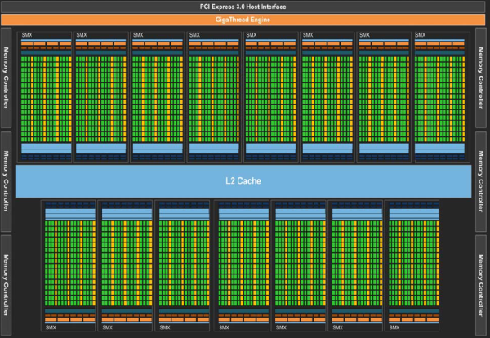
How do we execute code on a GPU: The SIMT model (Single Instruction Multiple Thread)
Turn source code into a scalar work-item
Map work-items onto an an N dim index space.
Run on hardware designed around the same SIMT execution model
extern void reduce( __local float*, __global float*);
__kernel void pi( const int niters, float step_size, __local float* l_sums, __global float* p_sums)
{
int n_wrk_items = get_local_size(0);
int loc_id = get_local_id(0);
int grp_id = get_group_id(0);
float x, accum = 0.0f; int i,istart,iend;
istart = (grp_id * n_wrk_items + loc_id) * niters;
iend = istart+niters;
for(i= istart; i<iend; i++){
x = (i+0.5f)*step_size; accum += 4.0f/(1.0f+x*x); }
l_sums[local_id] = accum;
barrier(CLK_LOCAL_MEM_FENCE);
reduce(l_sums, p_sums);
}
Map data structures onto the same index space
This is OpenCL kernel code … the sort of code the OpenMP compiler generates on your behalf
Third Party names are the property of their owners

Slide 19
How do we execute code on a GPU: OpenCL and CUDA nomenclature
Organize work-items into work-groups and map onto an an N dim index space. Cuda calls a work-group a thread-block
Turn source code into a scalar work-item (a CUDA thread)
Submit a kernel to an OpenCL command queue or a CUDA stream
extern void reduce( __local float*, __global float*);
__kernel void pi( const int niters, float step_size, __local float* l_sums, __global float* p_sums)
{
int n_wrk_items = get_local_size(0);
int loc_id = get_local_id(0);
int grp_id = get_group_id(0);
float x, accum = 0.0f; int i,istart,iend;
istart = (grp_id * n_wrk_items + loc_id) * niters;
iend = istart+niters;
for(i= istart; i<iend; i++){
x = (i+0.5f)*step_size; accum += 4.0f/(1.0f+x*x); }
l_sums[local_id] = accum;
barrier(CLK_LOCAL_MEM_FENCE);
reduce(l_sums, p_sums);
}
OpenCL index space is called an NDRange. CUDA calls this a Grid
This code defines a kernel
It’s called SIMT, but GPUs are really vector-architectures with a block of work-items called a warp executing together
Third Party names are the property of their owners

Slide 20

CUDA Toolkit
The CUDA toolkit works with code written in OpenMP 4.5 without any special configuration
We will demonstrate using an OpenMP 4.5 version of flow
Hydrodynamics mini-app solving Euler’s compressible equations

Slide 21
CUDA Toolkit: NVProf
Simple profiling: nvprof ./exe <params>
Time to copy data onto GPU
Time to copy data back from GPU
Profiling data
Timings for computational kernels

Slide 22
CUDA Toolkit: NVProf
Trace profiling: nvprof --print-gpu-trace ./exe <params>
Shows block sizes, grid dimensions and register counts for kernels
Entries ordered by time

Slide 23
Other CUDA Toolkit tools
nvidia-smi – displays some information about NVIDIA devices on a node
cudagdb – command line debugger in the style of GDB that allows kernel debugging
cuda-memcheck – tool to catch memory access errors in a CUDA application
nvvp – visual optimisation application that can use profiling data from nvprof

Slide 24
Exercise
Use the vadd program from the previous exercise and explore how it executes on a GPU using nvprof.
You will need to edit the job submission files to submit the job to the queue with nvprof. For example:
Replace the line
./vadd
with the line (for example)
nvprof --print-gpu-trace ./vadd
Use either:
nvprof ./vadd
nvprof --print-gpu-trace ./vadd
Change the problem size and get a feel for how the grid and block-size change.

Slide 25
Agenda
OpenMP overview
The device model in OpenMP
Understanding execution on the GPU with nvprof
Working with the target directive
Controlling memory movement
Optimizing GPU code
CPU/GPU portability

Slide 26
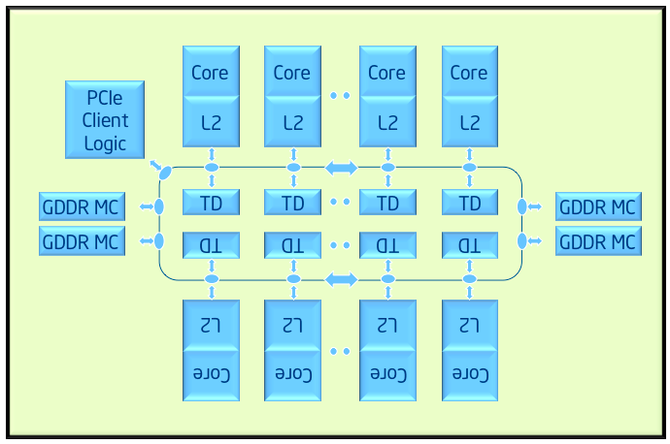
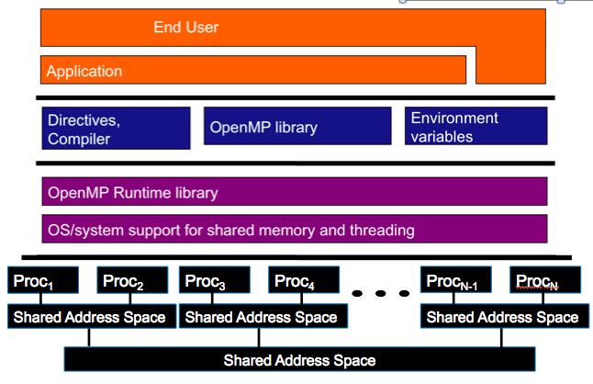
OpenMP device model: Examples
A couple key devices we considered when designing the device model in OpenMP
Target Device: Intel® Xeon Phi™ processor
Host
Target Device: GPU

Slide 27
A Generic Host/Device Platform Model
…
…
…
…
…
…
…
Processing Element
…
…
Host
…
…
…
…
…
…
Compute Unit
Device
One Host and one or more Devices
Each Device is composed of one or more Compute Units
Each Compute Unit is divided into one or more Processing Elements
Memory divided into host memory and device memory
Third party names are the property of their owners.

Slide 28
Our host/device Platform Model and OpenMP
…
…
…
…
…
…
…
Processing Element
…
…
Host
…
…
…
…
…
…
Target construct to get onto a device
Compute Unit
Device
Parallel for to run each block of loop iterations on the processing elements
Teams construct to create a league of teams with one team of threads on each compute unit.
Distribute clause to assign blocks of loop iterations to teams.

Slide 29
Our host/device Platform Model and OpenMP
Typical usage ... let the compiler do what’s best for the device:
…
…
…
#pragma omp target
to get on the device
…
…
…
…
Processing Element
…
…
Host
…
…
…
…
…
…
Target construct to get onto a device
Compute Unit
Device
Parallel for to run each block of loop iterations on the processing elements
Teams construct to create a league of teams with one team of threads on each compute unit.
Distribute clause to assign blocks of loop iterations to teams.
#pragma omp teams distribute parallel for
to assign work to the device processing elements

Slide 30
Consider the familiar VADD example
#include<omp.h>
#include<stdio.h>
#define N 1024
int main()
{
float a[N], b[N], c[N];
// initialize a, b and c ….
for(int i=0;i<N;i++)
c[i] += a[i] + b[i];
// Test results, report results …
}

Slide 31
Consider the familiar VADD example
#include<omp.h>
#include<stdio.h>
#define N 1024
int main()
{
float a[N], b[N], c[N];
// initialize a, b and c ….
#pragma omp target
#pragma omp teams distribute parallel for
for(int i=0;i<N;i++)
c[i] += a[i] + b[i];
// Test results, report results …
}
original variables i, a, b, c are copied to the device at beginning of construct
original variables a, b, c are copied to the host at the end of construct

Slide 32
Commonly used clauses on teams distribute parallel for
The basic construct is:
#pragma omp teams distribute parallel for [clause[[,]clause]...]
for-loops
The most commonly used clauses are:
reduction(reduction-identifier : list)
behaves as in the rest of OpenMP … but the variable must appear in a map(tofrom) clause on the associated target construct in order to get the value back out at the end
collapse(n)
Combines loops before the distribute directive splits up the iterations between teams
schedule(kind[, chunk_size])
only supports kind= static. Otherwise works the same as when applied to a for construct. Note: this applies to the operation of the distribute directive and controls distribution of loop iterations onto teams (NOT the distribution of loop iterations inside a team).

Slide 33
Controlling data movement
Data movement can be explicitly controlled with the map clause
int i, a[N], b[N], c[N];
#pragma omp target map(to:a,b) map(tofrom:c)
The various forms of the map clause
map(to:list): read-only data on the device. Variables in the list are initialized on the device using the original values from the host.
map(from:list): write-only data on the device: initial value of the variable is not initialized. At the end of the target region, the values from variables in the list are copied into the original variables.
map(tofrom:list): the effect of both a map-to and a map-from
map(alloc:list): data is allocated and uninitialized on the device.
map(list): equivalent to map(tofrom:list).
For pointers you must use array notation ..
map(to:a[0:N])

Slide 34
Default Data Mapping: Scalar variables (i.e. mapping scalars between host and target regions)
Default mapping behavior for scalar variables
OpenMP 4.0 implicitly mapped all scalar variables as tofrom
OpenMP 4.5 implicitly maps scalar variables as firstprivate
Key difference between the two options:
firstprivate:
a new value is created per work-item and initialized with the original value. The variable is not copied back to the host
map(tofrom):
A new value is created in the target region and initialized with the original value, but it is shared between work-items on the device. Its value is copied back to the host at the end of the target region.
Why is default firstprivate for scalars a better choice?
OpenMP target regions for GPUs execute with CUDA or OpenCL. A firstprivate scalar can be launched as a parameter to a kernel function without the overhead of setting up a variable in device memory.

Slide 35
Default Data Sharing
WARNING: Make sure not to confuse the implicit mapping of pointer variables with the data that they point to
int main(void) {
int A = 0;
int* B = (int*)malloc(sizeof(int)*N);
#pragma omp target
#pragma omp teams distribute parallel for
for(int i = 0; i < N; ++i) {
// A, B, N and i all exist here
// B is a pointer – the data B points to DOES NOT exist here!
} }
If you want to access the data that is pointed to by B, you will need to perform an explicit mapping using the map clause

Slide 36
Default Data Sharing
WARNING: Make sure not to confuse the implicit mapping of pointer variables with the data that they point to
int main(void) {
int A = 0;
int* B = (int*)malloc(sizeof(int)*N);
#pragma omp target map(tofrom: B[0:N])
#pragma omp teams distribute parallel for
for(int i = 0; i < N; ++i) {
// A, B, N and i all exist here
// The data that B points to DOES exist here!
} }

Slide 37
Exercise: Jacobi solver
Start from the provided jac_solv program. Verify that you can run it serially.
Parallelize for a CPU using the parallel for construct on the major loops
Use the target directive to run on a GPU.
#pragma omp target
#pragma omp target map(to: list[0:N]) map(from: list[0:N]) map(tofrom: list[0:N])
#pragma omp target teams distribute parallel for

Slide 38
Jacobi Solver (serial 1/2)
<<< allocate and initialize the matrix A and >>>
<<< vectors xold, xnew and b >>>
while((conv > TOL) && (iters<MAX_ITERS))
{
iters++;
for (int i=0; i<Ndim; i++){
xnew[i] = (TYPE) 0.0;
for (int j=0; j< Ndim;j++){
if(i!=j)
xnew[i]+= A[i*Ndim + j]*xold[j];
}
xnew[i] = (b[i]-xnew[i])/A[i*Ndim+i];
}

Slide 39
Jacobi Solver (serial 2/2)
conv = 0.0;
for (int i=0; i<Ndim; i++){
TYPE tmp = xnew[i]-xold[i];
conv += tmp*tmp;
}
conv = sqrt((double)conv);
TYPE* tmp = xold;
xold = xnew;
xnew = tmp;
} // end while loop

Slide 40
Jacobi Solver (Par Targ, 1/2)
while((conv > TOL) && (iters<MAX_ITERS))
{
iters++;
#pragma omp target map(tofrom: xnew[0:Ndim], xold[0:Ndim]) \
map(to: A[0:Ndim*Ndim], b[0:Ndim])
#pragma omp teams distribute parallel for
for (int i=0; i<Ndim; i++){
xnew[i] = (TYPE) 0.0;
for (int j=0; j<Ndim;j++){
if(i!=j)
xnew[i]+= A[i*Ndim + j]*xold[j];
}
xnew[i] = (b[i]-xnew[i])/A[i*Ndim+i];
}

Slide 41
Jacobi Solver (Par Targ, 2/2)
conv = 0.0;
#pragma omp target map(to: xnew[0:Ndim], xold[0:Ndim]) \
map(tofrom:conv)
#pragma omp teams distribute parallel for reduction(+:conv)
for (int i=0; i<Ndim; i++){
TYPE tmp = xnew[i]-xold[i];
conv += tmp*tmp;
}
conv = sqrt((double)conv);
TYPE* tmp = xold;
xold = xnew;
xnew = tmp;
} // end while loop

Slide 42
Jacobi Solver (Par Targ, 2/2)
conv = 0.0;
#pragma omp target map(to:xnew[0:Ndim], xold[0:Ndim]) map(tofrom:conv)
#pragma omp teams distribute parallel for reduction(+:conv)
for (int i=0; i<Ndim; i++){
TYPE tmp = xnew[i]-xold[i];
conv += tmp*tmp;
}
conv = sqrt((double)conv);
} // end while loop
This worked but the performance was awful. Why?
System | Implementation | Ndim = 4096
NVIDIA® K20X™ GPU | Target dir per loop | 131.94 secs
Cray® XC40™ Supercomputer running Cray® Compiling Environment 8.5.3. Intel® Xeon ® CPU E5-2697 v2 @ 2.70GHz with 32 GB DDR3. NVIDIA® Tesla® K20X, 6GB.
Third party names are the property of their owners.

Slide 43
Agenda
OpenMP overview
The device model in OpenMP
Working with the target directive
Controlling memory movement
Optimizing GPU code
CPU/GPU portability

Slide 44
Data movement dominates!!!
while((conv > TOLERANCE) && (iters<MAX_ITERS))
{ iters++;
#pragma omp target map(tofrom:xnew[0:Ndim],xold[0:Ndim]) \
map(to:A[0:Ndim*Ndim], b[0:Ndim])
#pragma omp teams distribute parallel for
for (int i=0; i<Ndim; i++){
xnew[i] = (TYPE) 0.0;
for (int j=0; j<Ndim;j++){
if(i!=j)
xnew[i]+= A[i*Ndim + j]*xold[j];
}
xnew[i] = (b[i]-xnew[i])/A[i*Ndim+i];
}
conv = 0.0;
#pragma omp target map(to:xnew[0:Ndim],xold[0:Ndim]) \
map(tofrom:conv)
#pragma omp teams distribute parallel for reduction(+:conv)
for (int i=0; i<Ndim; i++){
tmp = xnew[i]-xold[i];
conv += tmp*tmp;
}
conv = sqrt((double)conv);
// Pointer swap…
}
Typically over 4000 iterations!
Each iteration, copy (3*Ndim+Ndim²)*sizeof(TYPE) bytes to device
Each iteration, copy 2*Ndim*sizeof(TYPE) bytes from device
Each iteration, copy 2*Ndim*sizeof(TYPE) bytes to device

Slide 45
Target data directive
The target enter data and target exit data provide explicit control of the device data environment using map clauses
#pragma omp target enter data map(to: …)
#pragma omp target exit data map(from: …)
Data can be allocated and/or copied to the device on a target enter data, or copied back and/or destroyed with a target exit data
#pragma omp target enter data map(to: A[0:N],B[0:N],C[0:N])
#pragma omp target
{do lots of stuff with A, B and C}
{do something on the host}
#pragma omp target
{do lots of stuff with A, B, and C}
#pragma omp target exit data map(from: C[0:N])

Slide 46
Target update directive
You can update data between target regions with the target update directive.
#pragma omp target enter data map(to: A[0:N],B[0:N],C[0:N])
#pragma omp target
{do lots of stuff with A, B and C}
#pragma omp update from(A[0:N])
{do something on the host}
#pragma omp update to(A[0:N])
#pragma omp target
{do lots of stuff with A, B, and C}
#pragma omp target exit data map(from: C[0:N])
Copy A on the device to A on the host.
Copy A on the host to A on the device.

Slide 47
Exercise
Modify your parallel jac_solv from the last exercise.
Use the target enter data construct to create a data region. Manage data movement with map clauses to minimize data movement.
#pragma omp target enter data map(to: …)
#pragma omp target exit data map(from: …)
Array section syntax: array-name[offset : length], e.g. A[0:N]

Slide 48
Jacobi Solver (Par Targ Data, 1/2)
#pragma omp target enter data map(to:xold[0:Ndim], xnew[0:Ndim], \
A[0:Ndim*Ndim], b[0:Ndim])
while((conv > TOL) && (iters<MAX_ITERS))
{ iters++;
#pragma omp target
#pragma omp teams distribute parallel for
for (int i=0; i<Ndim; i++){
xnew[i] = (TYPE) 0.0;
for (int j=0; j<Ndim;j++){
if(i != j)
xnew[i]+= A[i*Ndim + j]*xold[j];
}
xnew[i] = (b[i]-xnew[i])/A[i*Ndim+i];
}

Slide 49
Jacobi Solver (Par Targ Data, 2/2)
conv = 0.0;
#pragma omp target map(tofrom: conv)
#pragma omp teams distribute parallel for reduction(+:conv)
for (int i=0; i<Ndim; i++){
TYPE tmp = xnew[i]-xold[i];
conv += tmp*tmp;
}
conv = sqrt((double)conv);
// Pointer swap
} // end while loop
#pragma omp target exit data map(from:xold[0:Ndim], xnew[0:Ndim])
System | Implementation | Ndim = 4096
NVIDA® K20X™ GPU | Target dir per loop | 131.94 secs
 | Above plus target enter data | 18.37 secs
Third party names are the property of their owners.

Slide 50
Agenda
OpenMP overview
The device model in OpenMP
Working with the target directive
Controlling memory movement
Optimizing GPU code
CPU/GPU portability

Slide 51
Single Instruction Multiple Data
Individual work-items of a warp start together at the same program address
Each work-item has its own instruction address counter and register state
Each work-item is free to branch and execute independently
Supports the SPMD pattern.
Branch behavior
Each branch will be executed serially
Work-items not following the current branch will be disabled
A warp
Time
Start
Branch1
Branch2
Branch3
Converge

Slide 52
Branching
GPUs tend not to support speculative execution, which means that branch instructions have high latency
This latency can be hidden by switching to alternative work-items/work-groups, but avoiding branches where possible is still a good idea to improve performance
When different work-items executing within the same SIMD ALU array take different paths through conditional control flow, we have divergent branches (vs. uniform branches)
Divergent branches are bad news: some work-items will stall while waiting for the others to complete
We can use predication, selection and masking to convert conditional control flow into straight line code and significantly improve the performance of code that has lots of conditional branches
Notes:
Branches will cause pipeline stalls if there’s no branch prediction/speculative execution

Slide 53
Branching
Conditional execution
Selection and masking
// Only evaluate expression
// if condition is met
if (a > b)
{
acc += (a - b*c);
}
// Always evaluate expression
// and mask result
temp = (a - b*c);
mask = (a > b ? 1.f : 0.f);
acc += (mask * temp);
Notes:
Mask 0 if a <= b
Single-cycle multiply-add means we get the extra multiplication by the mask for free
No branches means there won’t be any pipeline stalls
Subtle point: more instruction level parallelism in second example: the mul and sub can be issued independently from the setp and selp on dual-issue architectures

Slide 54
Coalesced Access
Coalesced memory accesses are key for high performance code
In principle, it’s very simple, but frequently requires transposing/transforming data on the host before sending it to the GPU
Sometimes this is an issue of Array of Structures vs. Structure of Arrays (AoS vs. SoA)

Slide 55
Memory layout is critical to performance
“Structure of Arrays vs. Array of Structures”
Array of Structures (AoS) more natural to code
struct Point{ float x, y, z, a; };
Point *Points;
x | y | z | a | … | x | y | z | a | … | x | y | z | a | … | x | y | z | a | …
Structure of Arrays (SoA) suits memory coalescence in vector units
struct { float *x, *y, *z, *a; } Points;
Adjacent work-items/vector-lanes like to access adjacent memory locations
x | x | x | x | … | y | y | y | y | … | z | z | z | z | … | a | a | a | a | …

Slide 56
Coalescence
for (int id = 0; id < size; id++)
{
// ideal
float val1 = memA[id];
// still pretty good
const int c = 3;
float val2 = memA[id + c];
// stride size is not so good
float val3 = memA[c*id];
// terrible
const int loc =
some_strange_func(id);
float val4 = memA[loc];
}
Coalesce - to combine into one
Coalesced memory accesses are key for high bandwidth
Simply, it means, if thread i accesses memory location n then thread i+1 accesses memory location n+1
In practice, it’s not quite as strict…

Slide 57
Memory access patterns
0
1
2
3
4
5
6
7
GPU Threads
0x0f4
0x0f8
0x0fc
0x100
0x104
0x108
0x10c
0x110
0x114
0x118
0x11c
0x120
0x124
0x128
64 Byte Boundary
GPU Memory
64 Byte Boundary

Slide 58
Memory access patterns
float val1 = memA[id];
0
1
2
3
4
5
6
7
0x0f4
0x0f8
0x0fc
0x100
0x104
0x108
0x10c
0x110
0x114
0x118
0x11c
0x120
0x124
0x128
64 Byte Boundary

Slide 59

Memory access patterns
const int c = 3;
float val2 = memA[id + c];
0
1
2
3
4
5
6
7
0x114
0x118
0x11c
0x120
0x124
0x128
0x12c
0x130
0x134
0x138
0x13c
0x140
0x144
0x148
64 Byte Boundary

Slide 60
Memory access patterns
float val3 = memA[3*id];
0
1
2
3
4
5
6
7
0x0f4
0x0f8
0x0fc
0x100
0x104
0x108
0x10c
0x110
0x114
0x118
0x11c
0x120
0x124
0x128
Strided access results in multiple
memory transactions (and
kills throughput)
64 Byte Boundary

Slide 61
Memory access patterns
const int loc =
some_strange_func(id);
float val4 = memA[loc];
0
1
2
3
4
5
6
7
0x0f4
0x0f8
0x0fc
0x100
0x104
0x108
0x10c
0x110
0x114
0x118
0x11c
0x120
0x124
0x128
64 Byte Boundary

Slide 62
Exercise
Modify your parallel jacobi_solver from the last exercise.
Experiment with the optimizations we’ve discussed.
Note: if you want to generate a transposed A matrix to try a different memory layout, you can use the following function from mm_utils
void init_diag_dom_near_identity_matrix_colmaj(int Ndim, TYPE *A)

Slide 63
Jacobi Solver (Par Targ Data, 1/2)
#pragma omp target enter data map(to:xold[0:Ndim],xnew[0:Ndim] \
A[0:Ndim*Ndim], b[0:Ndim])
while((conv > TOL) && (iters<MAX_ITERS))
{ iters++;
#pragma omp target
#pragma omp teams distribute parallel for
for (int i=0; i<Ndim; i++){
xnew[i] = (TYPE) 0.0;
for (int j=0; j<Ndim;j++){
xnew[i]+= (A[i*Ndim + j]*xold[j])*((TYPE)(i != j));
}
xnew[i] = (b[i]-xnew[i])/A[i*Ndim+i];
}

Slide 64
Jacobi Solver (Par Targ Data, 2/2)
conv = 0.0;
#pragma omp target map(tofrom: conv)
#pragma omp teams distribute parallel for reduction(+:conv)
for (int i=0; i<Ndim; i++){
TYPE tmp = xnew[i]-xold[i];
conv += tmp*tmp;
}
conv = sqrt((double)conv);
// Pointer swap
} // end while loop
#pragma omp target exit data map(from:xold[0:Ndim], xnew[0:Ndim])
System | Implementation | Ndim = 4096
NVIDA® K20X™ GPU | Target dir per loop | 131.94 secs
 | Above + target data region | 18.37 secs
 | Above + reduce branching | 13.74 secs
Cray® XC40™ Supercomputer running Cray® Compiling Environment 8.5.3. Intel® Xeon ® CPU E5-2697 v2 @ 2.70GHz with 32 GB DDR3. NVIDIA® Tesla® K20X, 6GB.
Third party names are the property of their owners.

Slide 65
Jacobi Solver (Targ Data/branchless/coalesced mem, 1/2)
#pragma omp enter target data map(from:xold[0:Ndim], xnew[0:Ndim] \ A[0:Ndim*Ndim], b[0:Ndim])
while((conv > TOL) && (iters<MAX_ITERS))
{ iters++;
#pragma omp target
#pragma omp teams distribute parallel for
for (int i=0; i<Ndim; i++){
xnew[i] = (TYPE) 0.0;
for (int j=0; j<Ndim;j++){
xnew[i]+= (A[j*Ndim + i]*xold[j])*((TYPE)(i != j));
}
xnew[i] = (b[i]-xnew[i])/A[i*Ndim+i];
}
We replaced the original code with a poor memory access pattern
xnew[i]+= (A[i*Ndim + j]*xold[j])
With the more efficient
xnew[i]+= (A[j*Ndim + i]*xold[j])

Slide 66
Jacobi Solver (Targ Data/branchless/coalesced mem, 2/2)
conv = 0.0;
#pragma omp target map(tofrom: conv)
#pragma omp teams distribute parallel for reduction(+:conv)
for (int i=0; i<Ndim; i++){
TYPE tmp = xnew[i]-xold[i];
conv += tmp*tmp;
}
conv = sqrt((double)conv);
// Pointer swap
} // end while loop
#pragma omp target exit data map(from:xold[0:Ndim], xnew[0:Ndim])
System | Implementation | Ndim = 4096
NVIDA® K20X™ GPU | Target dir per loop | 131.94 secs
 | Above plus target data region | 18.37 secs
 | Above plus reduced branching | 13.74 secs
 | Above plus improved mem access | 7.64 secs
Cray® XC40™ Supercomputer running Cray® Compiling Environment 8.5.3. Intel® Xeon ® CPU E5-2697 v2 @ 2.70GHz with 32 GB DDR3. NVIDIA® Tesla® K20X, 6GB.
Third party names are the property of their owners.

Slide 67
Agenda
OpenMP overview
The device model in OpenMP
Working with the target directive
Controlling memory movement
Optimizing GPU code
CPU/GPU portability

Slide 68
Compiler Support
Intel began support for OpenMP 4.0 targeting their Intel Xeon Phi coprocessors in 2013 (compiler version 15.0). Compiler version 17.0 and later versions support OpenMP 4.5
Cray provided the first vendor supported implementation targeting NVIDIA GPUs late 2015. The latest version of CCE now supports all of OpenMP 4.5.
IBM has recently completed a compiler implementation using Clang, that fully supports OpenMP 4.5. This is being introduced into the Clang main trunk.
GCC 6.1 introduced support for OpenMP 4.5, and can target Intel Xeon Phi, or HSA-enabled AMD GPUs. V7 added support for NVIDIA GPUs.
PGI compilers don’t currently support OpenMP on GPUs (but they do for CPUs).
OpenMP compiler information: http://www.openmp.org/resources/openmp-compilers/
Third party names are the property of their owners.

Slide 69
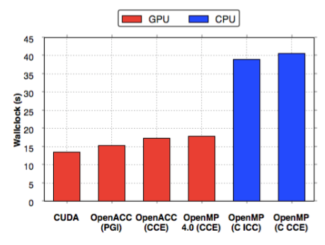
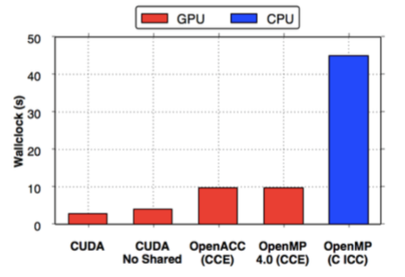
Performance?
* CCE 8.4.3, ICC 15.0.3, PGI 15.01, CUDA 7.0 on an NVIDIA® K20X, and Intel® Xeon® Haswell 16 Core Processor (E5-2698 v3 @ 2.30GHz)
CloverLeaf
Immediately we see impressive performance compared to CUDA
Clearly the Cray compiler leverages the existing OpenACC backend
BUDE
Even with OpenMP 4.5 there is still no way of targeting shared memory directly.
This is set to come in with OpenMP 5.0, and Clang supports targeting address spaces directly
Martineau, M., McIntosh-Smith, S. Gaudin, W., Evaluating OpenMP 4.0’s Effectiveness as a Heterogeneous Parallel Programming Model, 2016, HIPS’16
Third party names are the property of their owners.

Slide 70
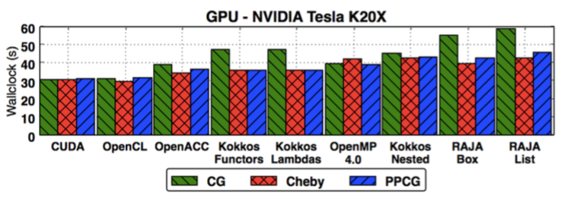
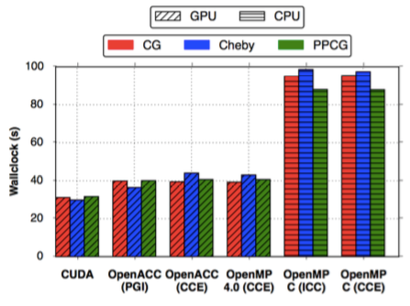
Performance?
* CCE 8.4.3, ICC 15.0.3, PGI 15.01, CUDA 7.0 on an NVIDIA® K20X, and Intel® Xeon® Haswell 16 Core Processor (E5-2698 v3 @ 2.30GHz)
TeaLeaf
We found that Cray’s OpenMP 4.0 implementation achieved great performance on a K20x
It’s likely that these figures have improved even more with maturity of the portable models
Martineau, M., McIntosh-Smith, S. Gaudin, W., Assessing the Performance Portability of Modern Parallel Programming Models using TeaLeaf, 2016, CC-PE
Third party names are the property of their owners.

Slide 71
How do you get good performance?
Our finding so far:
You can achieve good performance with OpenMP 4.5.
We achieved this by:
Keeping data resident on the device for the greatest possible time.
Collapsing loops with the collapse clause, so there was a large enough iteration space to saturate the device.
Using nvprof to careful optimise each kernel.

Slide 72
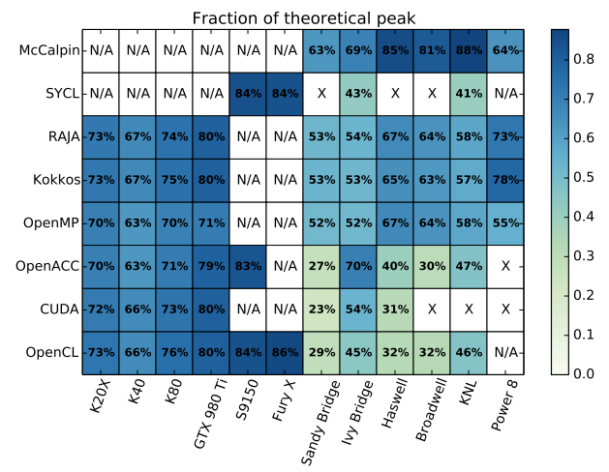
OpenMP in The Matrix.
System Details on the following slide
On those supported target architectures, OpenMP achieves good performance
Deakin, T., Price, J., Martineau, M., McIntosh-Smith, S., GPU-STREAM v2.0 Benchmarking the achievable memory bandwidth of many-core processors across diverse parallel programming models, ISC’16
Third party names are the property of their owners.

Slide 73
System details
Abbreviation | System details
K20X | Cray® XC40, NVIDIA® K20X GPU, Cray compilers version 8.5, gnu 5.3, CUDA 7.5
K40 | Cray® CS cluster, NVIDIA® K40 GPU, Cray compilers version 8.4, gnu 4.9, CUDA 7.5
K80 | Cray® CS cluster, NVIDIA® K40 GPU, Cray compilers version 8.4, gnu 4.9, CUDA 7.5
S9150 | AMD® S9150 GPU. Codeplay® copmputeCpp compiler 2016.05 pre-release. AMD-APP OpenCL 1.2 (1912.5)drivers for SyCL. PGI® Accelerator)TM) 16.4 OpenACC
GTX 980 Ti | NVIDA® GTX 980 Ti. Clang-ykt fork of Clang for OpenMP. PGI® Accelerator™ 16.4 OpenACC. CUDA 7.5
Fury X | AMD® Fury X GPU (based on the Fiji architecture).
Sandy Bridge | Intel® Xeon® E5-2670 CPU. Intel® compilers release 16.0. PGI® Accelerator)TM) 16.4 OpenACC and CUDA-x86. Intel® OpenCL runtime 15.1. Codeplay® copmputeCpp compiler 2016.05 pre-release
Ivy Bridge | Intel® Xeon® E5-2697 CPU. Gnu 4.8 for RAJA and Kokkos, Intel® compiler version 16.0 for stream, Intel® OpenCL runtime 15.1. Codeplay® copmputeCpp compiler 2016.05 pre-release.
Haswell | Cray® XC40, Intel® Xeon® E5-2698 CPU. Intel® compilers release 16.0. PGI® Accelerator)TM) 16.3 OpenACC and CUDA-x86. Gnu 4.8 for RAJA and Kokkos
Broadwell | Cray® XC40, Intel® Xeon® E5-2699 CPU. Intel® compilers release 16.0. PGI® Accelerator)TM) 16.3 OpenACC and CUDA-x86. Gnu 4.8 for RAJA and Kokkos
KNL | Intel® Xeon® Phi™7210 (knights landing) Intel® compilers release 16.0. PGI® Accelerator)TM) 16.4 OpenACC with target specified as AVX2.
Power 8 | IBM® Power 8 processor with the XL 13.1 compiler.
Deakin, T., Price, J., Martineau, M., McIntosh-Smith, S., GPU-STREAM v2.0 Benchmarking the achievable memory bandwidth of many-core processors across diverse parallel programming models, ISC’16

Slide 74
Combined Construct
For performance, prefer to use the full combined construct:
#pragma omp target teams distribute parallel for
The construct makes a lot of guarantees to the compiler, enabling optimisations.
Real applications will have algorithms that are structured such that they can’t immediately use the combined construct – you have to port your code for the GPU.

Slide 75
Conclusion
You can program your GPU with OpenMP
Implementations of OpenMP supporting target devices are evolving rapidly … expect to see great improvements in quality and diversity.

